Slide 1
Commercial Lending with BAFS
Credit Union Growth Strategies

Slide 2
Credit unions and business banking
Only 9% of U.S. consumers now identify a credit union as their primary FI
Now, many credit unions are turning to small business clients as a new growth engine

Slide 3




Why start a commercial program?
Start to engage with your local community, supporting small businesses across your area.
  Deepen Member Relationships
      Serve the full financial needs of these members
  Support Community Development
      Create local jobs and expand services
  Enhance Competitiveness
      Position yourself as a full-service financial partner

Slide 4


Raddon Insights: What the data shows
7.5
Commercial loans only reached 7.5% of CU assets - a still modest market
(2025 Q1)
Business lending is a high-growth diversification play for CUs, but today it represents a small slice of their portfolios – meaning there’s significant headroom to grow.
8
Only 8% of small business borrowers applied at a CU vs 79% at banks
(2021)
CUs hold only 5% of business loans and 2% of business credit cards vs 60% and 75% held by the top five banks (2023)
5
2

Slide 5
Exploring the Solution with BAFS
Commercial Lending with Portico Integration

Slide 6
BAFS and Portico Integration
The Current Process – File Transfer
    Daily Loan Data Import
        BAFS sends a morning balance/status file with all updated commercial loan details.
        Portico imports the file and displays information on the member overview screen.
    Payment Handling & Return File
        Members make payments in Portico, which are collected throughout the day.
        Portico batches these payments and sends a return file to BAFS for posting at end-of-day.
The Future Goal - Web-Service Integration
    The long-term goal is to replace batch exchanges with instant web-service calls that update loans in real-time across Portico and digital channels, reducing reliance on evening batch files while keeping the morning summary file.
Under current integration, BAFS maintains ownership and servicing of the loans, while Portico displays loan information and processes member payments through daily data exchange.

Slide 7
Consultative Discovery for FREE
Phase 0 – The Discovery
    Understanding YOUR Strategic Goals
        Discussing the vision, growth objectives, and desired outcome from a commercial lending program.
    Assessing Capability
        Reviewing existing systems, processes, and team expertise to identify strengths and readiness through gap analysis.
    Industry-Based Feedback
        Providing insights and recommendations grounded in industry expertise and best practices.
Free personalized consultation provided by industry leaders with decades of experience, serving clients across a variety of needs and goals.

Slide 8
Next steps: Insight and Planning
Phase 1 - Insight
  Market Analysis
    Evaluate local market trends and demographics to spot lending opportunities and risks
  Financial Insights
    Analyze CU financial strength, performance, and risk tolerance for lending
  Operational Needs
    Outline resources and processes for loan origination, underwriting, and servicing
  Strategic Assessment
    Create a roadmap to boost member value and diversify revenue through lending.
Phase 2 - Planning
  Go-to-Market Strategy & Growth Plan
    Define target segments, value proposition, and market insights to guide positioning
    Outline product implementation and sales/distribution plans for growth
  Operational Execution & Governance
    Allocate budget and resources, assign team roles, and train the board for oversight
    Establish policies, procedures, and required documentation for business products

Slide 9
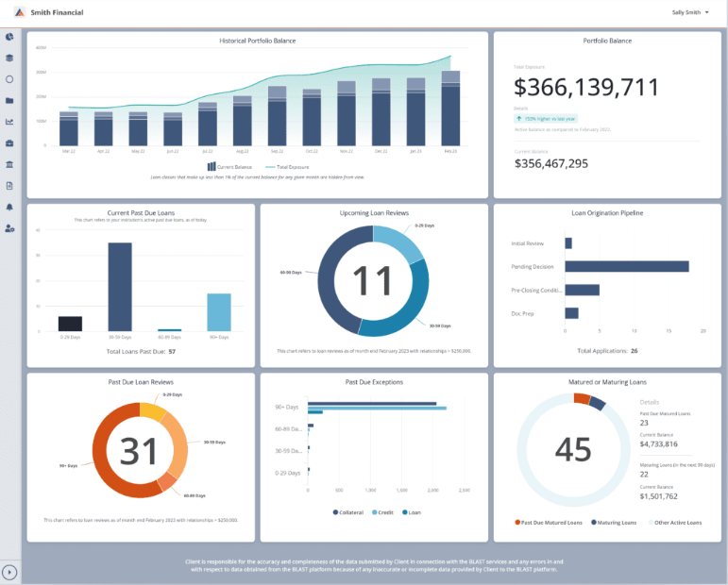
Implementing
YOUR
Solution
Phase 3 – Implementation
    Commercial lending plan installation
    BLAST platform customization and training
    Data integration to Portico and borrower portal
    Participation group access
Deploying the commercial program at your pace with our guidance, providing comprehensive services to guide you through every step of the journey.

Slide 10
BAFS
Blueprint Advantage
Discovery
FREE, personalized consultation to assess need
Insight
Data-driven analysis to forecast risk and opportunities
Planning
Go-to-Market strategy and operational execution
Implementation
Deploying processes and infrastructure integrated to Portico

Slide 11
Why this matters for Fiserv RMs
Sell a clear top-line growth story, and build a meaningful relationship with your client
Unlock loan and deposit value to directly boost your client’s revenue, translating to bigger renewal wins, expansion dollars, and quota attainment

Slide 12
Your Next Steps:
What we can do now…
Schedule a FREE Discovery call with at least one client through the first half of 2026

Slide 13
BAFS and Portico
Serve your community

